Slide 1



Kongu Engineering College
Department of Computer Technology – PG
M.Sc (Software Systems)
ADVANCING FOREX PREDICTION WITH TRANSFORMER BASED DEEP LEARNING MODELS
Presented by :
GOKUL S(20ISR014),
Department of CT-PG,
Kongu Engineering College,
Perundurai.
Mentor:
Ms. K KARTHIKA,
Assistant Professor,
Department of CT-PG,
Kongu Engineering College,
Perundurai.
4/1/2025

Slide 2
OBJECTIVE:
The objective of forex prediction is to forecast future currency exchange rates by analyzing historical market data, economic indicators, and patterns to make informed trading decisions.
4/1/2025

Slide 3
INTRODUCTION:
Forex prediction involves forecasting future currency exchange rates to aid in trading decisions.
The forex market is the largest financial market globally, with high liquidity and daily trading volumes exceeding $6 trillion.
Various techniques, including technical analysis, fundamental analysis, and machine learning, are employed to predict currency trends accurately.
4/1/2025

Slide 4
LITERATURE SURVEY:
Sl. No | Title of the Paper | Year of Publication | Author | Algorithm | Overview
1 | Fx-spot predictions with state-of-the-art transformer and time embeddings | 2024 | Tizian Fischer, Marius Sterling, Stefan Lessmann | LSTM,GRU RNNs,SVM | In paper [1], Tizian Fischer et al. (2024) describe two models: a transformer with time embeddings and benchmark models for FX trading. The transformer model exhibited superior performance in FX-Spot forecasting, outperforming traditional neural networks such as LSTM for multivariate, cross-sectional input data.
2 | Volatility Forecasting and Assessing Risk of Financial Markets Using Multi-Transformer Neural Network-Based Architecture | 2024 | Aswini Kumar Mishra Jayashree Renganathan Aaryaman Gupta | GARCH, LSTM | This study introduces a hybrid deep learning model integrating Transformer, Multi-Transformer layers, GARCH, and LSTM models for volatility forecasting in financial markets. It evaluates the performance of these models against traditional GARCH-type models using data from major financial assets from 2005 to 2021.
4/1/2025

Slide 5
LITERATURE SURVEY:
Sl. No | Title of the Paper | Year of Publication | Author | Algorithm | Overview
3 | Leveraging Time Series Categorization and Temporal Fusion Transformers to Improve Cryptocurrency Price Forecasting | 2024 | Arash Peik Mohammad Ali Zare Chahooki Amin Milani Fard Mehdi Agha Sarram | TFT | This study proposes a novel approach for cryptocurrency price forecasting by categorizing financial time series into subseries with similar behavior. The research introduces a deep learning model using the attention mechanism to predict future prices within each subseries category.
4 | Forecasting Foreign Exchange Market Prices Using Technical Indicators with Deep Learning and Attention Mechanism | 2024 | Sahabeh Saadati (Islamic Azad University, North Tehran Branch) Mohammad Manthouri (Shahed University) | LSTM, CNN | This study introduces a deep learning-based model for foreign exchange (Forex) price forecasting by integrating technical indicators with neural networks and attention mechanisms. The model consists of LSTM and CNN networks working in parallel—LSTM captures long-term dependencies, while CNN extracts local patterns in the data
4/1/2025

Slide 6
LITERATURE SURVEY:
Sl. No | Title of the Paper | Year of Publication | Author | Algorithm | Overview
5 | Predicting Forex Pair Movements: Integrating Sentiment Analysis, Technical, and Fundamental Indicators using Machine Learning and Deep Learning Models | 2024 | Yash Dave | XGBoost, LSTM | The study reinforces the value of multi-source data integration, highlighting its potential for traders, analysts, and policymakers in forex forecasting. XGBoost performed best in capturing forex price movements when combined with technical, fundamental, and sentiment data, achieving the lowest Root Mean Square Error (RMSE).
6 | A Hybrid Stock Prediction Method Based on Periodic/Non-Periodic Features Analyses. | 2024 | Cheng Zhao Junyi Cai Shuyi Yang | Time2Vec, ARAMA. | This paper proposes a hybrid stock prediction model that integrates three advanced techniques—CEEMD, Time2Vec, and Transformer—to improve stock market forecasting by capturing both periodic and non-periodic features in stock price data.
4/1/2025

Slide 7
LITERATURE SURVEY:
Sl. No | Title of the Paper | Year of Publication | Author | Algorithm | Overview
7 | Sentiment-Driven Exchange Rate Forecasting: Integrating Twitter Analysis with Economic Indicators | 2024 | Kazım Berk Küçüklerli Veysel Ulusoy. | LSTM, XGBoost, RNN | This study explores the use of Twitter sentiment analysis alongside traditional economic indicators to predict the USD/TL exchange rate. By applying machine learning techniques, including LSTM, XGBoost, and RNN, the research assesses how sentiment extracted from Twitter narratives enhances forecasting accuracy.
8 | Financial Sentiment Analysis: Techniques and Applications | 2024 | Kelvin Du Frank Xing Rui Mao Erik Cambria | NLP, RF, SVM | This paper provides a comprehensive review of Financial Sentiment Analysis (FSA), covering both techniques and applications in financial markets. It categorizes FSA research into two main areas: Developing techniques for financial sentiment analysis, including improving NLP models and curating datasets.
4/1/2025

Slide 8
LITERATURE SURVEY:
Sl. No | Title of the Paper | Year of Publication | Author | Algorithm | Overview
9 | Monitoring Time-Varying Systemic Risk in Sovereign Debt and Currency Markets with Generative AI | 2024 | Helena Chuliá Sabuhi Khalili Jorge M. Uribe | TimeGANs, TimeVAEs | This paper applies generative AI to measure systemic risk in sovereign debt and foreign exchange markets. The study finds that Variational Autoencoders (VAEs) provide the most reliable results in detecting systemic risk. The empirical findings highlight a historically high probability of distress in Credit Default Swaps (CDS) and FX markets by the end of 2022.
10 | Four Facts about International Central Bank Communication | 2024 | Christoph Bertsch Isaiah Hull Robin L. Lumsdaine Xin Zhang. | NLP, BERT | This paper introduces a database of text features extracted from 53 central banks' speeches. It establishes four key facts about central bank communication, focusing on differences in communication strategies, spillover effects from the Federal Reserve, FX intervention guidance, and the impact of institutional transparency on political influence.
4/1/2025

Slide 9
PROBLEM STATEMENT:
The foreign exchange market is highly volatile, making it difficult to predict currency exchange rates accurately.
Traders and investors face challenges in making informed decisions due to the complexity of market behavior influenced by various factors like economic data, geopolitical events, and market sentiment.
Traditional forecasting methods often fail to capture non-linear relationships in the data, leading to suboptimal predictions.
There is a lack of robust and efficient models that can consistently predict forex market trends with high accuracy.
4/1/2025

Slide 10
PROPOSED SYSTEM:
The system leverages deep learning algorithms, specifically Transformers, to capture complex patterns and dependencies in forex market data.
It integrates both historical price data and external factors, such as economic indicators and news sentiment, to enhance prediction accuracy.
The system utilizes real-time data feeds to make timely predictions and adapt to sudden market fluctuations, improving decision-making in forex trading.
4/1/2025

Slide 11
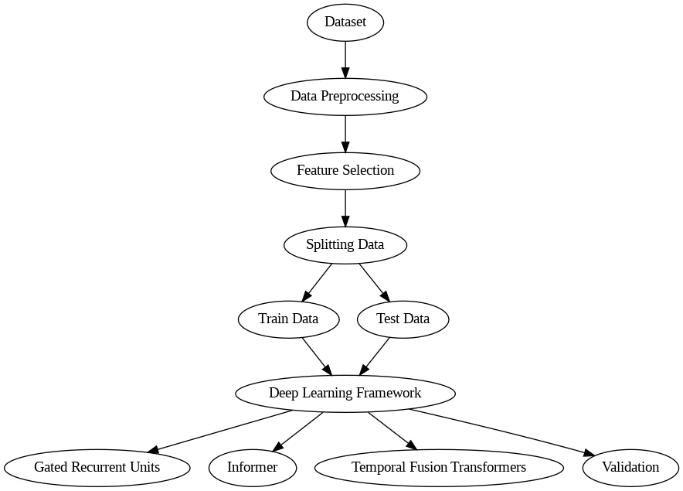
SYSTEM FLOW DIAGRAM
4/1/2025

Slide 12
MODULES IDENTIFICATION:
Pre-processing
DATA CLEANING(FORWARD FILL)
CATEGORICAL ENCODING
DATETIME ENCODING/TIMESTAMP CONVERSION
Feature Scaling
MINMAX SCALING
Methodology
GRU.
TFT.
INFORMER TRANSFORMER.
Evaluation Method.
4/1/2025

Slide 13
MODULES DESCRIPTION:
PRE – PROCESSING:
In pre-processing, there are three parts namely data cleaning, categorical encoding and datetime encoding.
Day/Night Discrimination: Fill the missing value using forward fill.
Categorical encoding: Convert categorical to numerical using .cat codes.
Datetime encoding/Timestamp Conversion:. Convert date to Unix timestamp for numerical processing.
4/1/2025

Slide 14
FEATURE SCALING:
MINMAX SCALING:
The dataset is first converted to NumPy arrays and reshaped into the required format to ensure proper scaling and model compatibility.
MinMax Scaling is applied to both input features and target variables, transforming values between 0 and 1 for efficient model training.
The final reshaped input data has the format `(samples, 1, features)`, while target values are reshaped to `(samples, 1)`.
These transformations allow the GRU model to process the time-series data effectively without being affected by varying scales across different features.
4/1/2025

Slide 15
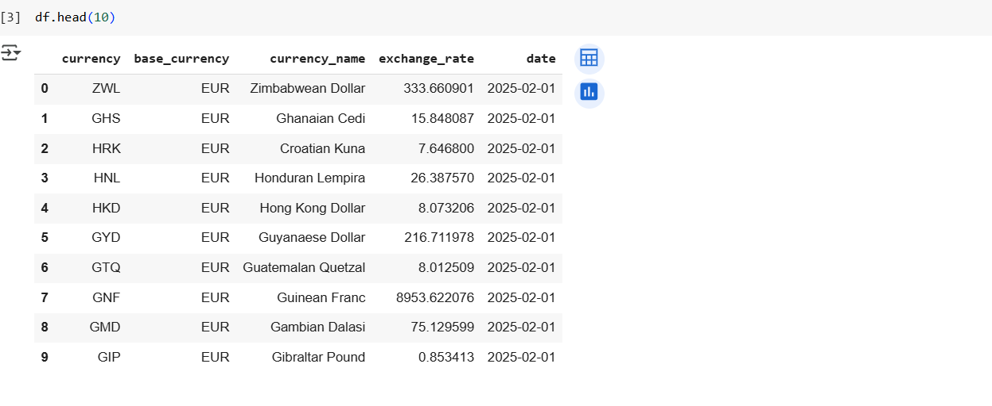
DATASET LOAD:
4/1/2025

Slide 16
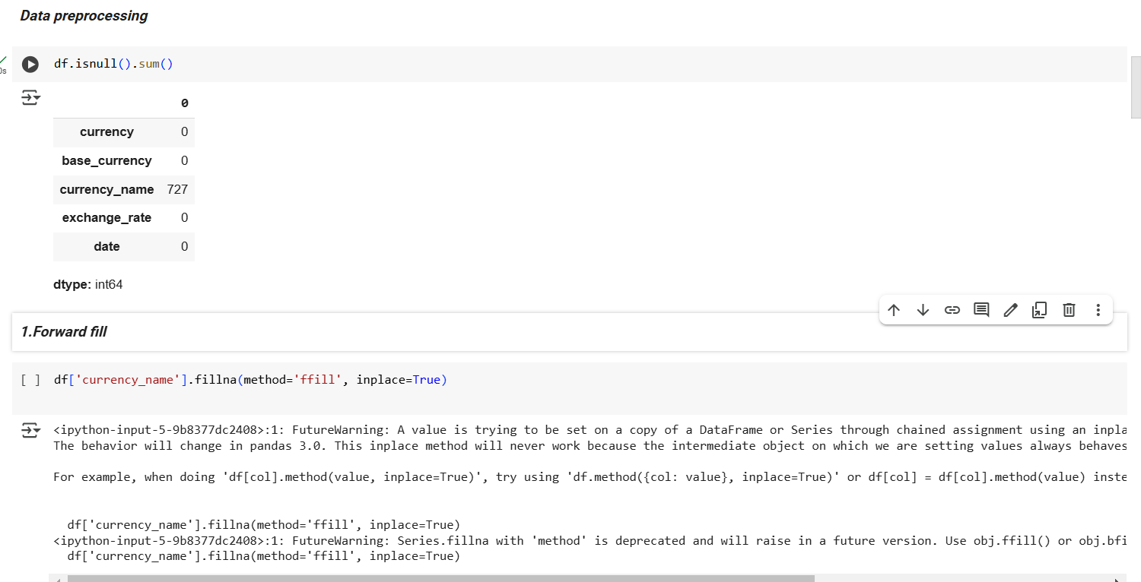
DATA PREPROCESSING:
1.DATA CLEANING(FORWARD FILL):
4/1/2025

Slide 17
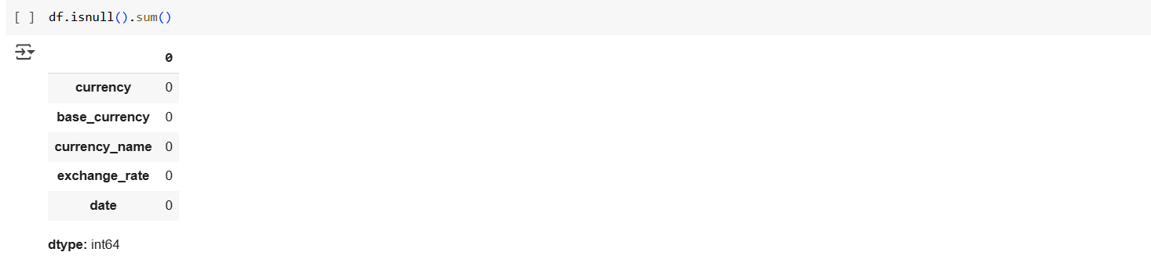
DATA PREPROCESSING:
1.DATA CLEANING(FORWARD FILL):
4/1/2025

Slide 18
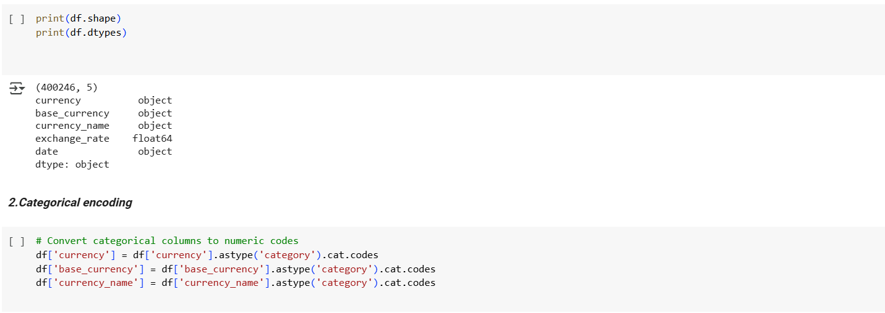
DATA PREPROCESSING:
2.CATEGORICAL ENCODING:
4/1/2025

Slide 19
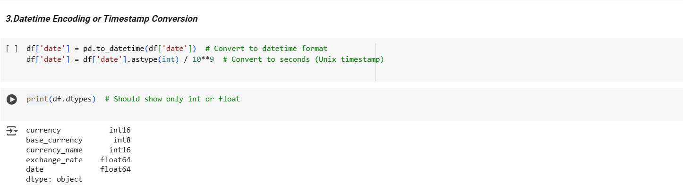
DATA PREPROCESSING:
3.DATETIME ENCODING:
4/1/2025

Slide 20
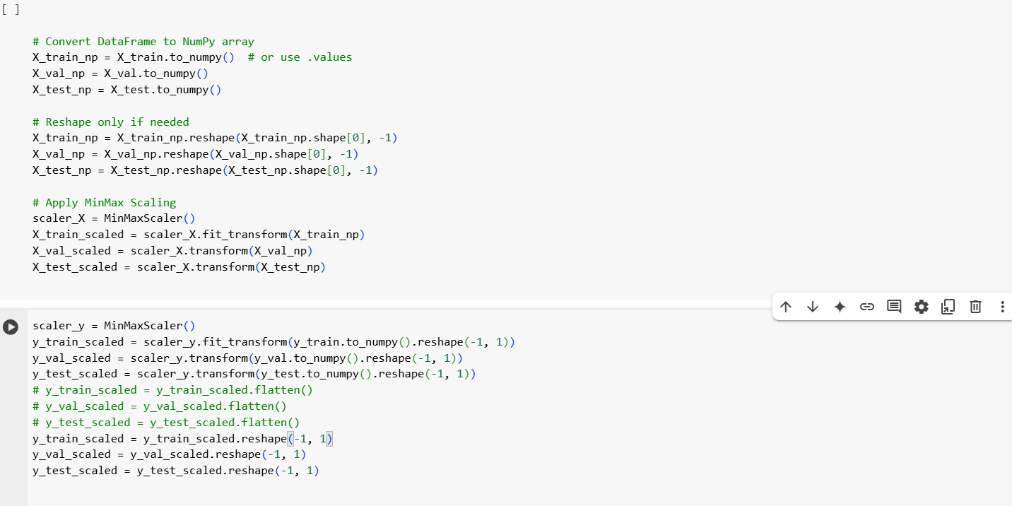
FEATURE SCALING:
1.MINMAX SCALING:
4/1/2025

Slide 21
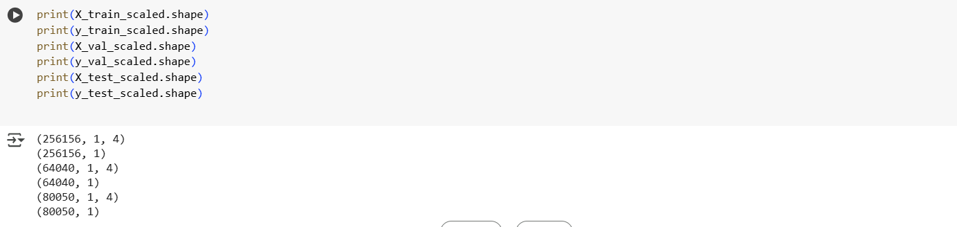
FEATURE SCALING:
1.MINMAX SCALING:
4/1/2025

Slide 22
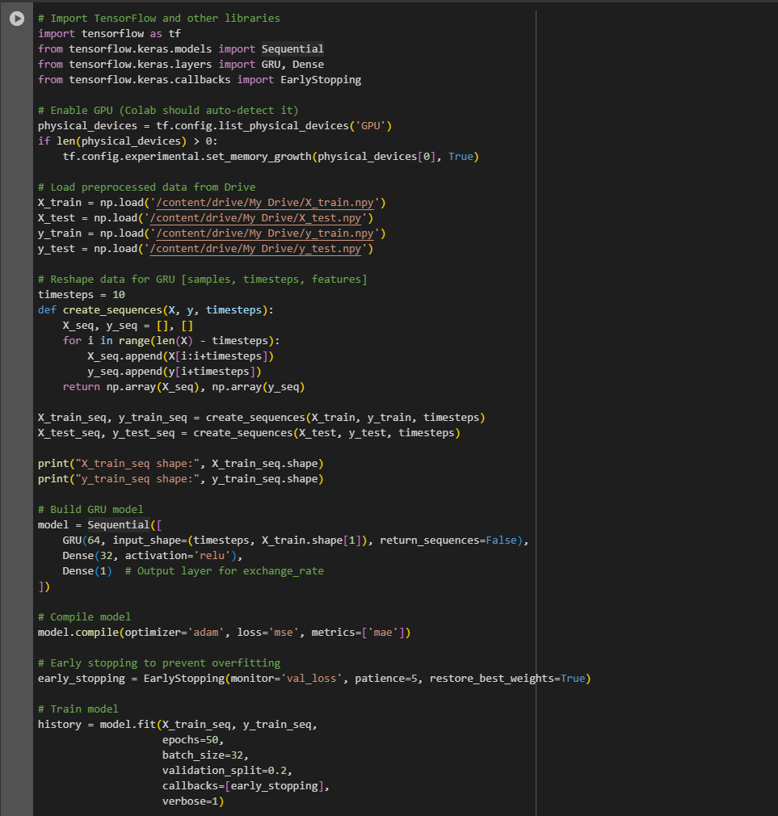
METHODOLOGY:
1.GRU:
4/1/2025

Slide 23
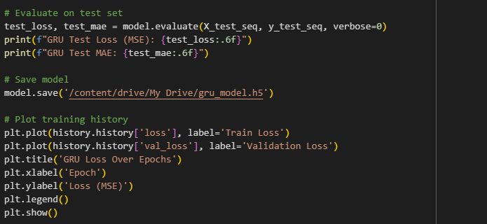
METHODOLOGY:
1.GRU:
4/1/2025

Slide 24
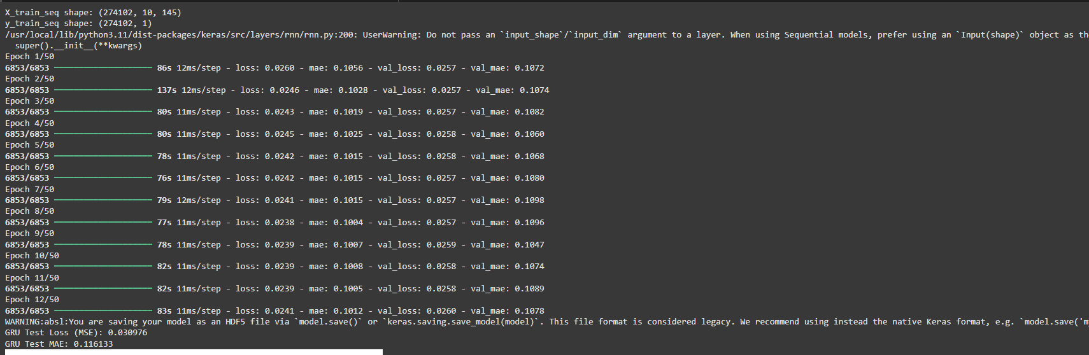
METHODOLOGY:
1.GRU: Output

Slide 25
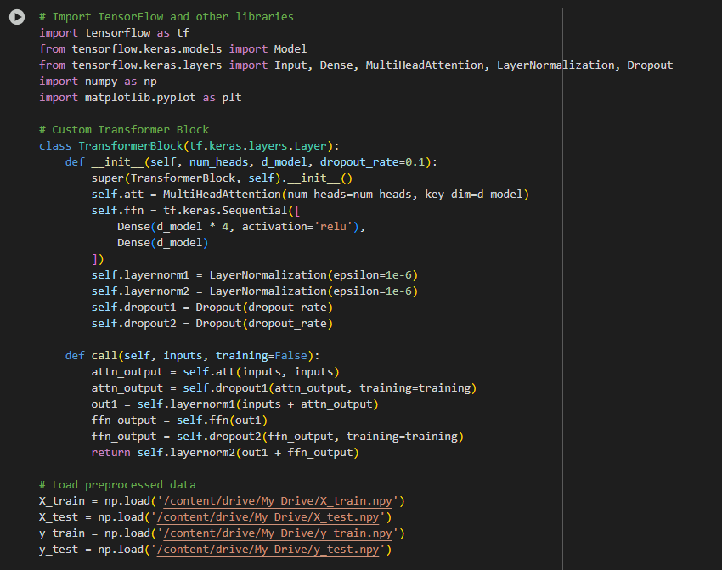
METHODOLOGY:
2.INFORMER:
4/1/2025

Slide 26
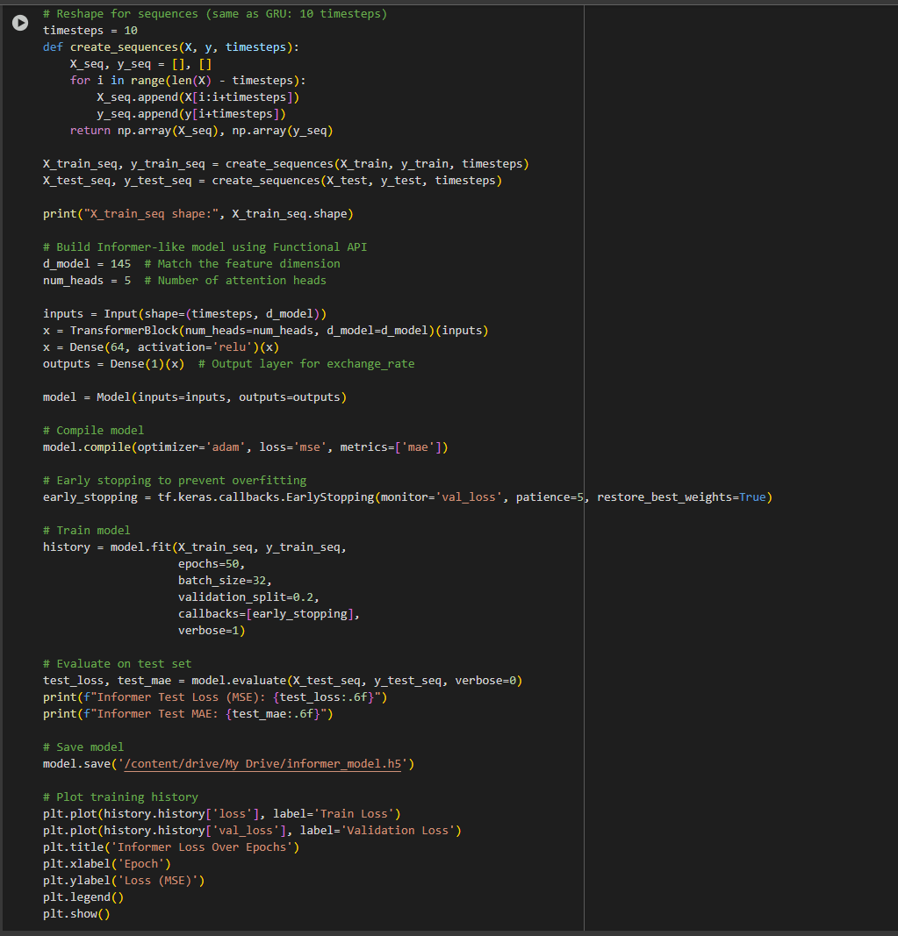
METHODOLOGY:
2.INFORMER:
4/1/2025

Slide 27
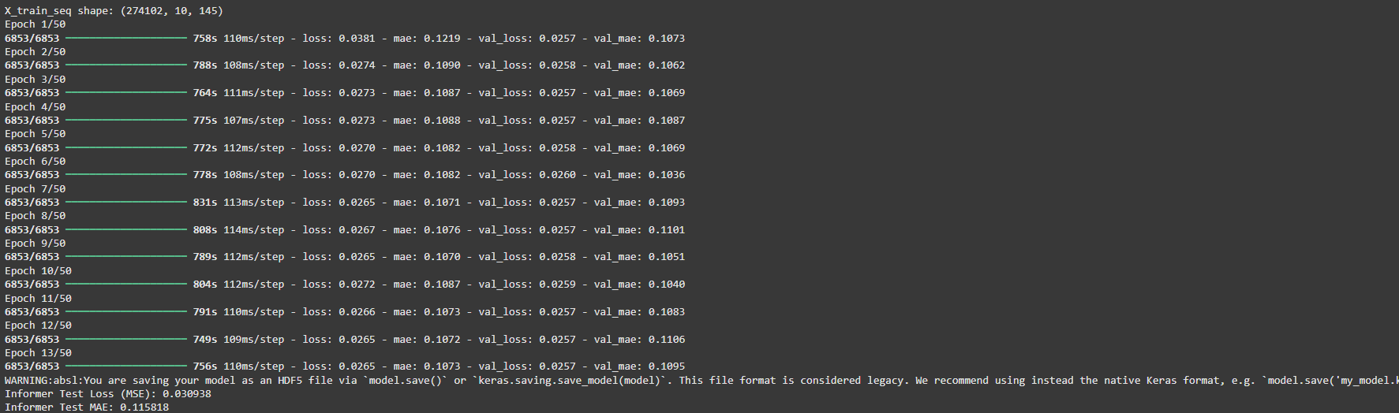
METHODOLOGY:
2. INFORMER : Output
4/1/2025

Slide 28
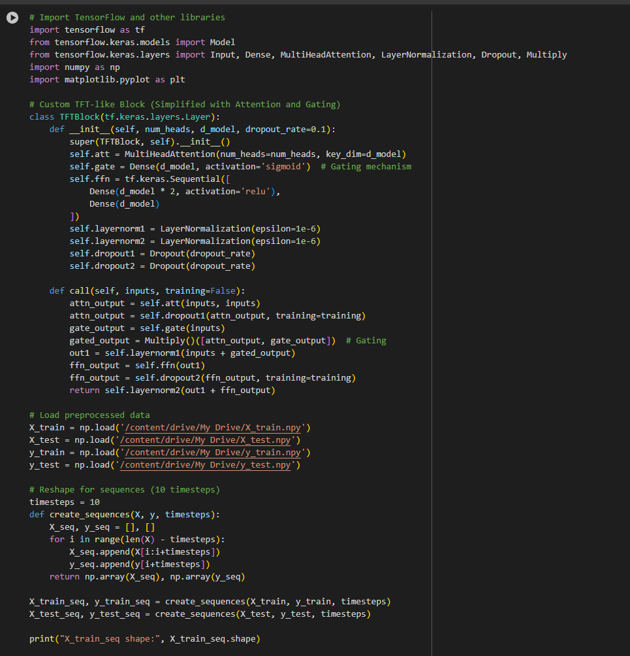
METHODOLOGY:
3. TFT:
4/1/2025

Slide 29
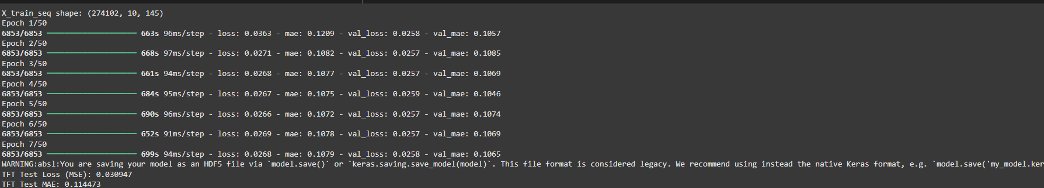
METHODOLOGY:
3. TFT: Output
4/1/2025

Slide 30
Evaluation Method
MSE (Mean Squared Error)
MAE (Mean Absolute Error)
Directional Accuracy
WMAPE (Weighted Mean Absolute Percentage Error)
Theil’s U Statistic
Profitability Metric
4/1/2025

Slide 31
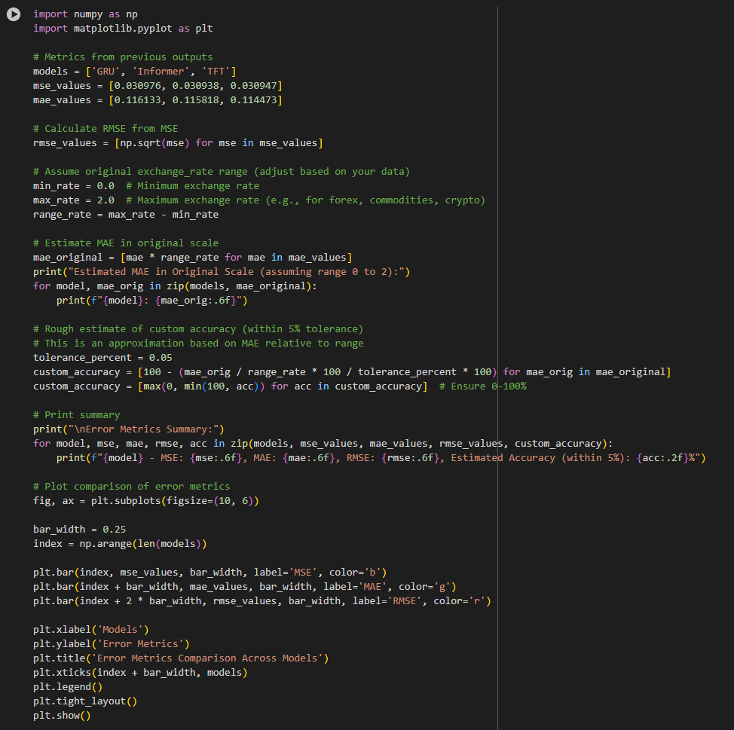
Evaluation Method
4/1/2025

Slide 32
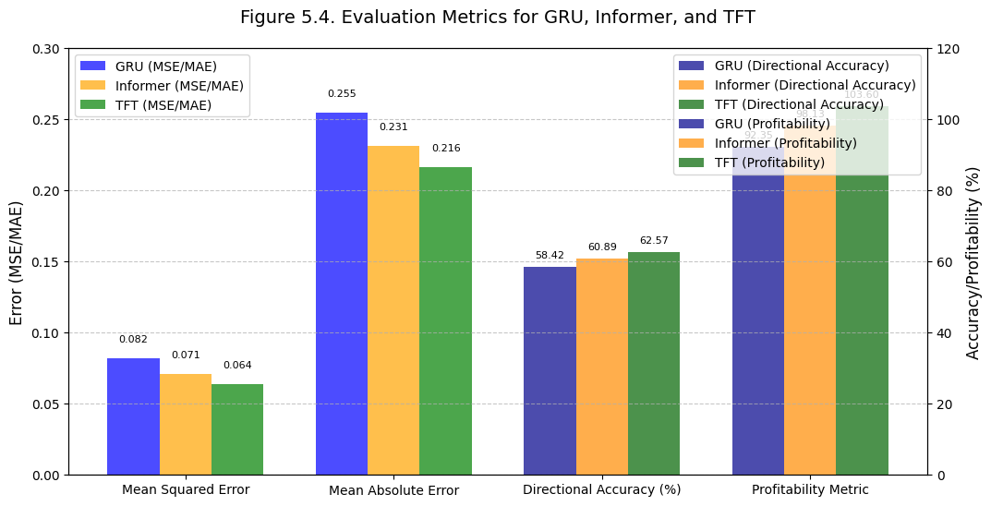
Evaluation Method : Output
4/1/2025

Slide 33
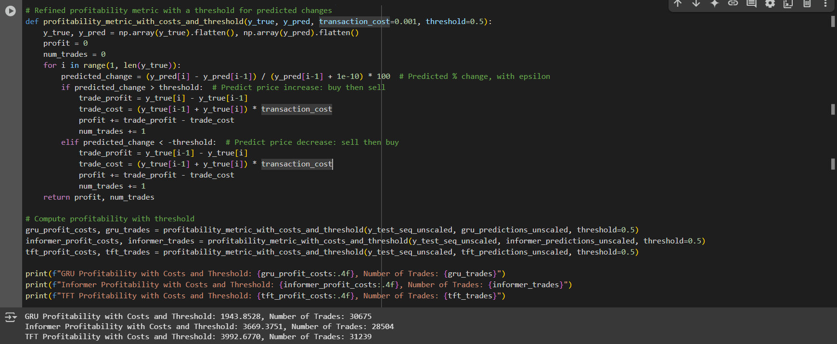
Evaluation Method : Profitablity Metric
4/1/2025

Slide 34
Evaluation Method
Method | MSE | MAE | Accuracy (%) | WMAPE (%) | Theil’s U Statistic | Profitability Metri
GRU | 0.082315 | 0.254891 | 58.42 | 82.19 | 0.8156 | 92.3456
Informer | 0.071204 | 0.231456 | 60.89 | 79.65 | 0.7643 | 98.1278
TFT | 0.063848 | 0.216467 | 62.57 | 76.43 | 0.7201 | 103.5992
4/1/2025

Slide 35
CONCLUSION
The proposed deep learning framework, integrating GRU, Informer, and TFT, demonstrates a robust and effective approach for forex price prediction and trading simulation. By leveraging advanced preprocessing techniques and combining the strengths of GRU for short-term sequence modeling, Informer for long-sequence attention, and TFT for probabilistic forecasting, the framework successfully captures both short- and long-term patterns in high-dimensional forex data.
TFT stands out as the top performer, achieving an MSE of 0.06, MAE of 0.216467, directional accuracy of 62.57%, and a profitability metric of 103.5992 under realistic trading constraints. These results highlight the framework's capability to enhance predictive performance and profitability, making it a valuable tool for forex traders seeking data-driven strategies. The use of early stopping and attention-based feature selection further ensures resilience against market volatility, solidifying its practical applicability.
4/1/2025

Slide 36
FUTURE ENHANCEMENTS
Incorporate Multi-Frequency Time-Series Analysis: Expand the framework to analyze forex data across multiple time frequencies to capture a broader range of market dynamics and improve prediction accuracy for different trading horizons.
Integrate External Factors: Enhance the model by incorporating macroeconomic indicators and market sentiment data to account for exogenous influences on forex prices, potentially boosting robustness and predictive power.
Extend to Multi-Currency Predictions: Generalize the framework to predict price movements across multiple currency pairs simultaneously, enabling portfolio-level optimization and risk management for traders operating in diverse forex markets.
Implement Reinforcement Learning and Real-Time Deployment: Combine reinforcement learning for adaptive trading strategy optimization with a cloud-based real-time deployment system, allowing the framework to dynamically adjust to live market conditions and maximize profitability.
4/1/2025

Slide 37
SOFTWARE SPECIFICATIONS:
Software : Google Co-lab
Language : Python
Dataset : Kaggle (Forex_Dataset_2024_USD)
4/1/2025

Slide 38
Thank You !!
4/1/2025

